Slide 1
A University of Pittsburgh Town Hall
Sponsored by the National rehabilitation research and training center on Family Support

Slide 2
National Rehabilitation Research and Training (RRT) Center on Family Support
Notes:
Center based out of Pittsburgh
Our mission is to partner with government, academia, and the family caregiver community to transform research into services and programs. Our goal is to improve the care, health, and QoL of people with disabilities and the families that support them.
We know that the current coronavirus pandemic bring with it fear and uncertainty, especially for family caregivers, who are facing an unprecedented situation. We hope that today’s webinar will provide you with some clear information, and answers to questions that you might have.
We’ll be recording the webinar today, and we’ll e-mail out a link to watch it to anyone who registered. Thanks to those who sent in their questions ahead of time. For any questions that come up as the presenters are speaking, please type them into the chat window on your Zoom screen and we’ll cover them after the presenters have finished.
All attendees will receive a survey following the end of today’s presentation; we’d really appreciate it if you would fill it out to help us improve our future programming.

Slide 3
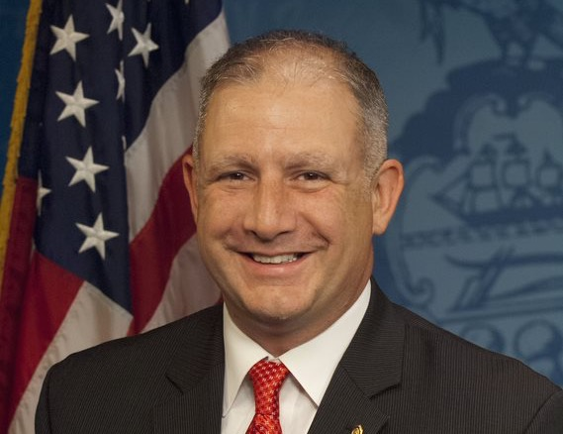
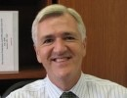
Our Panelists
Dan Miller Pennsylvania State Representative,
Everette James, Director, University of Pittsburgh Health Policy Institute
Amber Thompson Family Caregiver Chief Consultant, Leaders of Change
Michelle Sipple Family Caregiver Vice President, Achieva Family Trust

Slide 4
Effects of COVID-19 on Family Caregivers A Community Survey from the University of Pittsburgh
Scott Beach, PhD Co-Director, National RRT Center on Family Support
Interim Director, UCSUR

Slide 5
Survey design & Participants
Cross sectional community survey
April 15 - May 27, 2020
Responses were received from
619 family caregivers
2,933 noncaregivers
Assessment of COVID-19 impacts on employment, financial well-being, social interactions, health behaviors, and physical and mental health.

Slide 8
Covid-19 concerns

Slide 9
RECENT changes in emotional well-being, Mental Health, and physical health
Caregivers also scored significantly worse on validated measures of depression and anxiety

Slide 10
Financial concerns and food insecurity

Slide 11
COVID-19 has changed FAMILY CAREGIVER DUTIES AND RESPONSIBILITIES
Providing care became more difficult—emotionally, physically, and financially
Access to health care was interrupted
Lifestyle changes due to COVID led to
increases in worry, fear, depression and sleep problems
family disagreements or conflict over caring for the care recipient.

Slide 12
Some caregivers are at higher risk during the pandemic
Female
Younger (<45 years old)
Caregivers of colo
No college education and/or lower income
Caring for someone with emotional/behavioral issues
Caring for children/ young adults
Caregivers who live with the carer recipient

